Slide 1

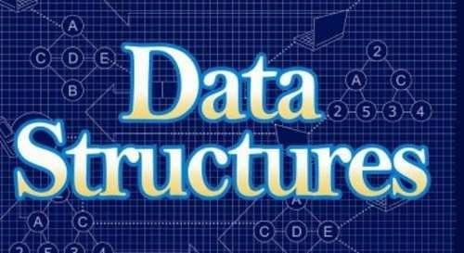
Sajan Kharel
25th February-2019

Slide 2
Content
Data Structure
Pseudo code
Abstract Data Type
Atomic and Composite Data
Algorithm Header

Slide 3

What is Data Structure ?
DATA
A way of storing data in computer
Can be used efficiently
Allow the most efficient algorithm to reuse
It can be seen as logical concept

Slide 4
Pseudo Code ???
An English representation of algorithm
Consist of an extended version of the basic algorithm construct
Common tools for defining algorithm
Part of structure code
Consist of sequence selection and iteration

Slide 5
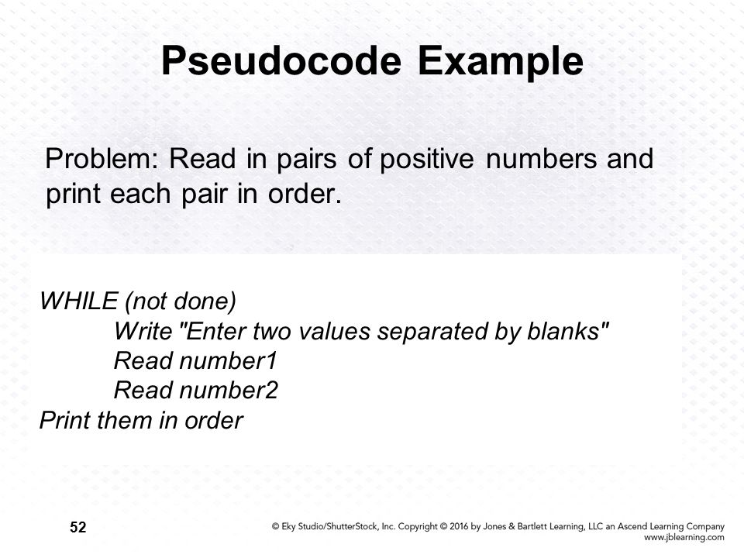

Slide 6
Abstract Data Type (ADT)
A logical description of how we view the data and how they will be implemented
Concern only with what data is representing eventually be constructed
Consist of data declaration package with operation to make meaningful on the data while data filling & encapsulation

Slide 7
Implementation of Abstract Data Type
Array Implementation
Sequentially of a list is maintain by the ordered structure of elements in the array index.
Liked list implementation
Ordered collection of data
Contains the location of the next element or elements

Slide 8
Atomic and Composite Data
Atomic or Primitive Data
Data that consist of single piece of information, non-decomposable
Example: Integer number like: 5, 3, 6, temperature: 37, 50 etc…
Composite Data
Data that can be broken down into sub field that have meaning, decomposable
Example: Telephone number

Slide 9
Algorithm Header
Algorithm that start with names called algorithm header
Describes its parameters and list any pre and post condition
It most be complete enough to communicate to the programmer
Example of Header:
Algorithm sample(ref pageno<integer>)
This algorithm reads a file & prints a report
Pre: Pageno. must be initialized
Post: Report printed. Pageno. Contain number of pages in report
Return: Number of lines printed

Slide 10

Any Queries ???

